Slide 1
Project 3 : Data Visualisation
Factors determining academic success
Francesca Kim
Ironhack Data Analytics Part Time June 2020
Francesca Kim / © 2020

Slide 2

I hope you all had good lunch. Because this is another data set to prove why eating well is important

Slide 3
Agenda
Data set & libraries used
Objectives & hypothesis
Insight & visualisations
For the next step

Slide 4

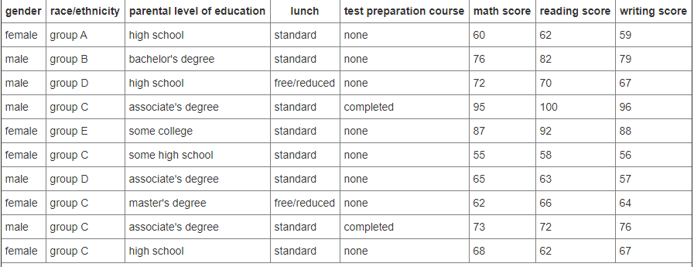
Data set & libraries used
Source :
Kaggle, 2018, US, Students Performance in Exams
Libraries used :
Seaborn
MatplotLib
Data set : 1000 students

Slide 5
Identify factors that can determine students’ academic
success
Questions to ask & process to follow
How does student’s linguistic skill impact math score?
Does a student’s gender play a role in math and language score?
Can your parental educational background influence your score?
Can hunger influence your score?
Objectives & process
Francesca Kim / © 2020

Slide 6
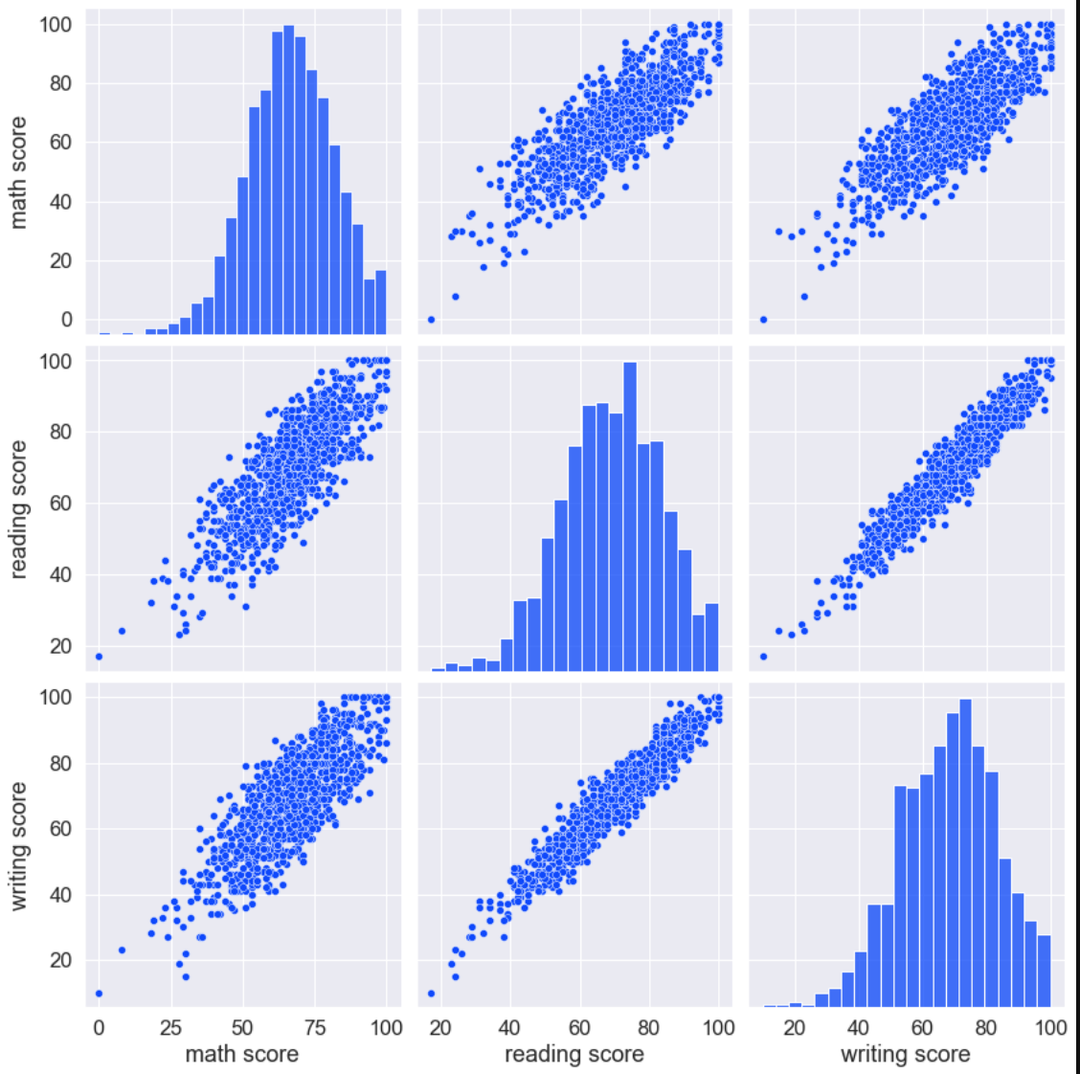
Reading and writing scores have high correlations whilst there is no correlation between linguistic score and math score

Slide 7
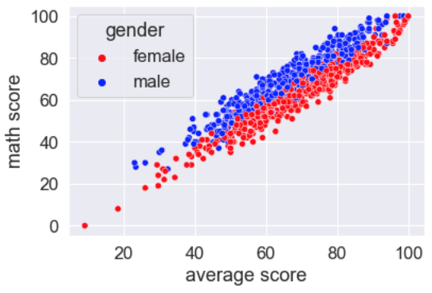
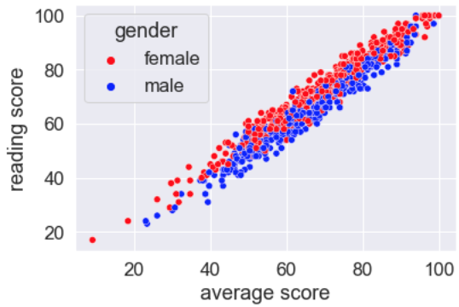
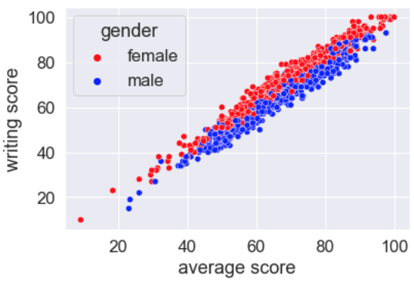
The moment when the stereotype comes true… In this data set, male students excelled in math scores more so than their counterparts.
Reading & writing
Math
VS

Slide 8
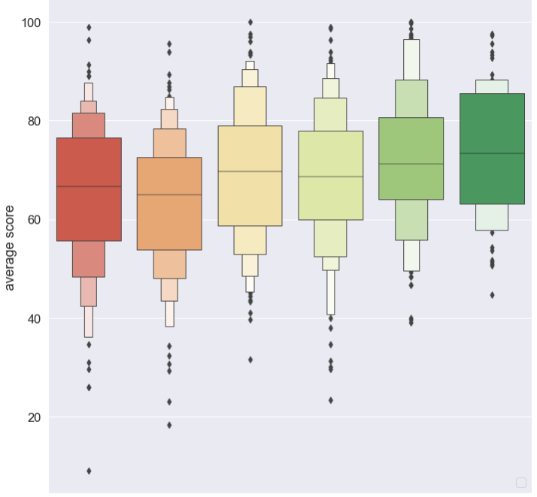
Students with highly educated parents had a better chance to succeed academically
Middle school diploma
High school diploma
Associate’s degree
Uncompleted BA
Bachelor’s
Master’s
Avr.Score
Parental educational background & average score of each students

Slide 9
Students whose parents with minimal educational level have a higher chance of lagging behind.
Middle school diploma
High school diploma
Associate’s degree
Uncompleted BA
Bachelor’s
Master’s
Avr.Score
Parental educational background & average score of each students
Even the underscored outliers from these groups scored much higher than the students from the bottom 2 groups

Slide 10
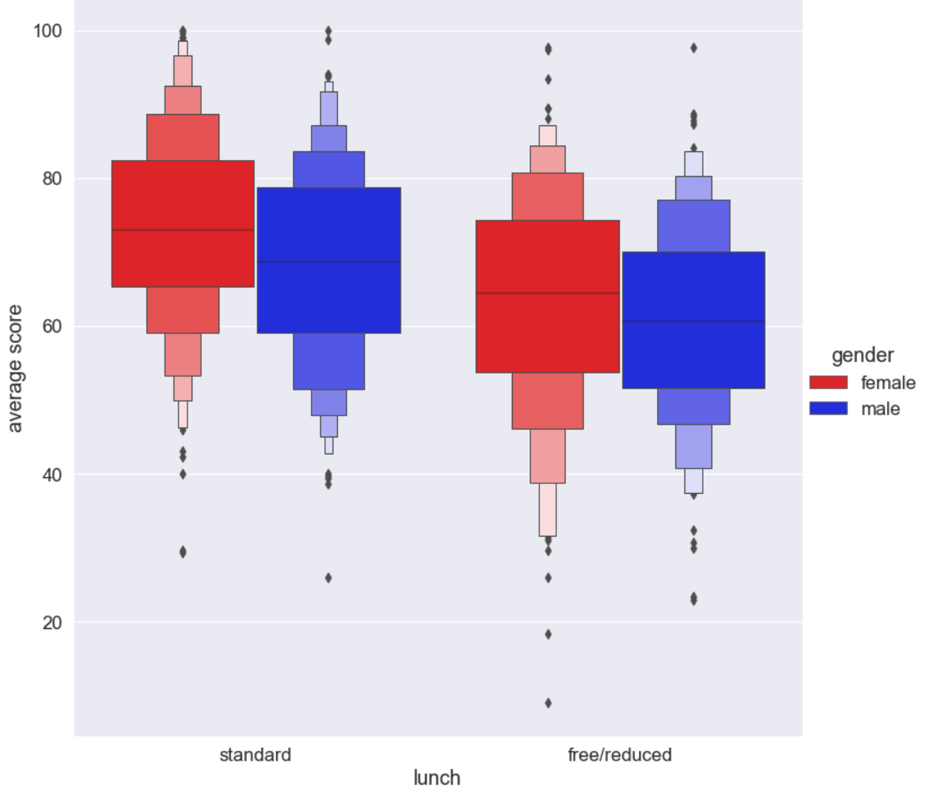
Eating well before exam is important. Students who had lunch before the exam scored higher than those who didn’t.
Q: did you have lunch before the exam?
Yes
No
Avr.Score

Slide 11
For female students especially, doing exam with empty-stomach has strong negative impact on the academic performance
Q: did you have lunch before the exam?
Yes
No
Avr.Score

Slide 12

No need for us to feel guilty : )
The data says
it’s ok to indulge

Slide 13
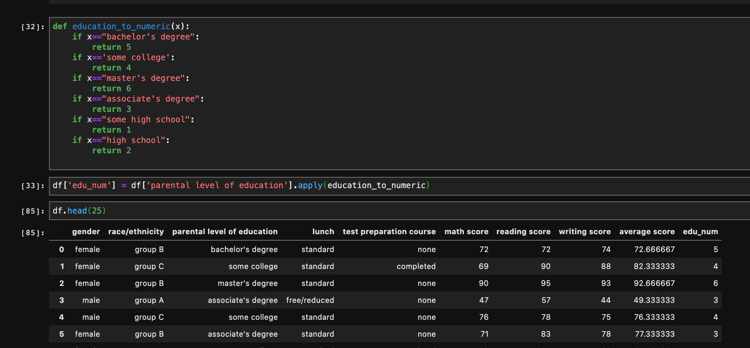
The most helpful code tip from Louk

Slide 14
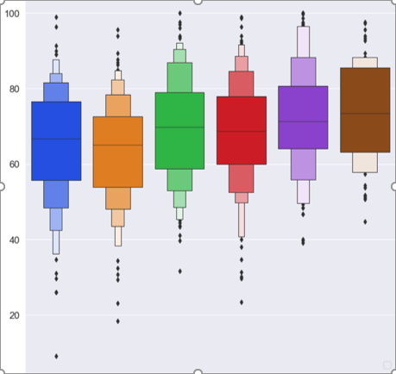
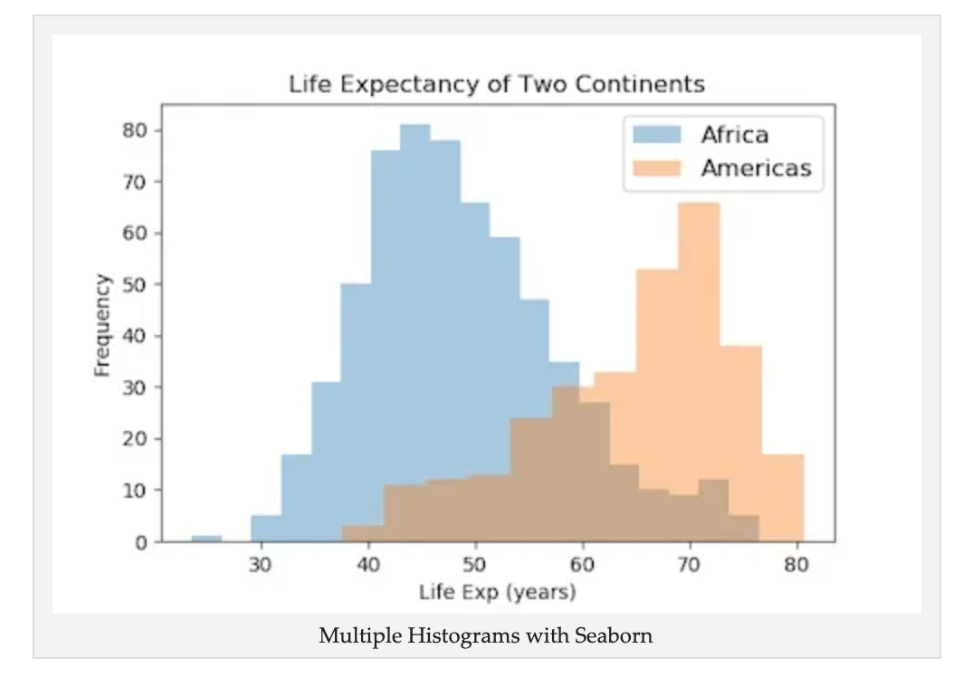
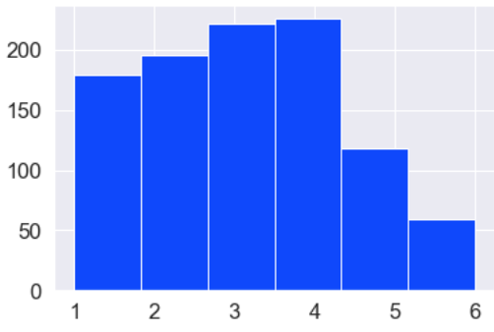
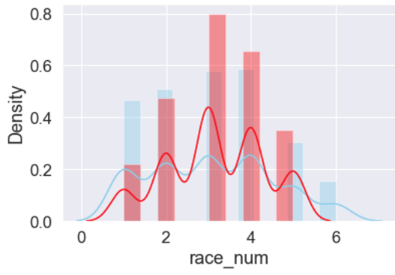
What I couldn’t solve
#1
#2
#3
Couldn’t figure out how to customize colour palette of catplot lib
Couldn’t figure out exporting the graphs to png, jpeg and with legends.
Also how can you add data label?
Couldn’t figure out split histograms
180

Slide 15
THANK YOU.

